Slide 1

Sentiment Analysis on Big Data of Social and Polticial events
By
Rowan Menezes
Suraj Jayakumar
Project Guide: Prof. Dr. Indiramma M

Slide 2
Introduction
What is Big Data?
Big data is a broad term for data sets so large that traditional data processing applications are inadequate
Why is there a boom?
Organizations create and store more transactional data in digital form
Big Data allows ever-narrower segmentation of customers and therefore much more precisely tailored products or services
What is sentiment Analysis? (Opinion Mining)
Process of computationally identifying and categorizing opinions expressed in a piece of text in order to determine the writer's attitude towards a particular topic is positive, negative or neutral.

Slide 3
Problem statement and Target
Issues we are trying to solve?
To build a comprehensive and efficient sentiment analyzer for social and political topics such that given a message, classify whether the message is of positive, negative or neutral sentiment.
For messages conveying both positive and negative sentiments, whichever is the stronger sentiment is chosen.
Target Users?
Politicians
Firms and Organizations
Normal end users

Slide 4
Viability
USA 2012 election – Obama Victory
How President Obama’s campaign used big data to rally individual voters
Core team of Data Scientists
Stocks price prediction based on market movements
The correlation between news articles and stock variations is already proved
Personalized Recommendations by e-Commerce sites

Slide 5
Social Impact
Politicians will get a feedback on public opinion on their actions
Example – Recent Comment on SRK by Kailash Vijayvargiya which said his “soul” was in Paksitan which resulted in a public outrage (could be avoided using this)
People can monitor public view about their MLA/MP in that constituency
Example – People get a holistic opinion about their elected representative

Slide 6
Social Impact
Firms/Companies will get a comprehensive analysis of the event they organized
Recent Flipkart's Big Billion Day vs Amazon's Sale
We can predict the maximum reach of a Politician’s social media message based on past history
Example - Maximum reach to public on Thursday 8pm
Feedback mechanism for any new law passed and new movie released

Slide 7
Challenges
Sarcasm
My hostel WiFi speed clearly has to be fastest in the world.
Context / Domain Dependence
The story of the movie was really unpredictable.
Actions of my MLA are totally unpredictable.
Thwarted Expectations
Start one direction and end it with opposite meaning
Media attached to tweets/ social media message
@Sachin_RT: Virat's batting today has been t.co/alPoLX

Slide 8
Challenges
Pragmatics (Awwwesome, BAD)
Awwwesomeee vs Awesome
BAD vs bad
Chat corpus (diz, wer, der)
Word Knowledge
He is a Hitler
Comparative
Modi is much better than Rahul Gandhi
External Links
Breaking News: Modi says <link>

Slide 9
So Whats New?
Machine Learning
Naive-Bayes Classifier
Classification using Maximum Entropy
Support Vector Machines (SVM)
Deep Learning
Neural Networks

Slide 10
SOFTWARE REQUIREMENTS
Big data processing engine – Apache Spark with pySpark
Machine Learning tool kit – scikit-learn, mllib, weka
Neural Networks – pyBrain
Querying Language – SparkSQL, Hive
Data Collection – NoSql, MongoDB
In-Memory Data Structure Store – redis
Visualization Tools – matplotlib, bokeh, ggplot, pandas

Slide 11
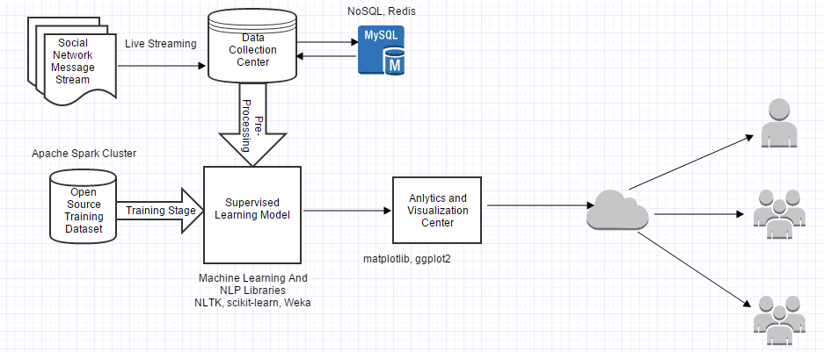
TECHNOLOGY STACK

Slide 12
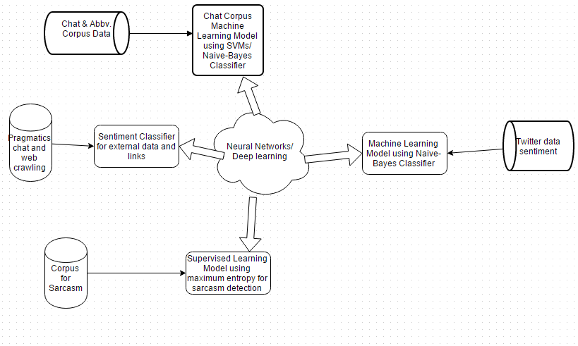
Supervised Learning Model Architecture

Slide 13
Rough Estimate
PRODUCT | COST
Distributed Cluster Server + 96GB Ram (Optional) | ₹1,00,000/-
Cloud Storage | ₹2,000/-
Input Training Dataset | ₹5,000/-
Data Streams | ₹4,500/-

Slide 14
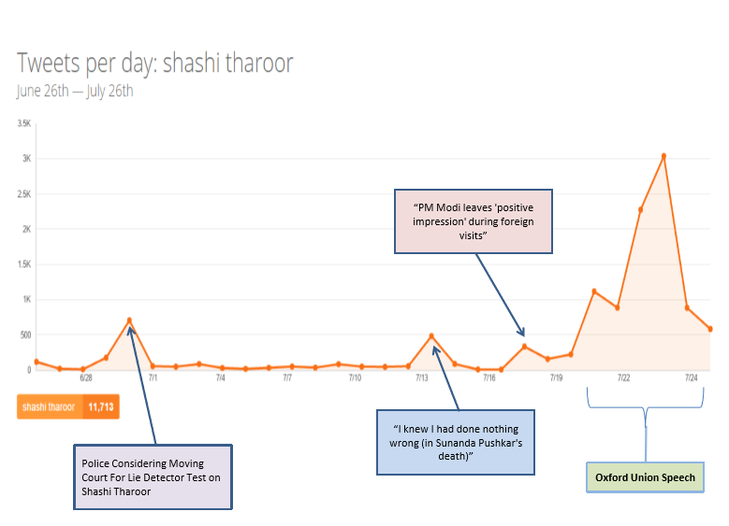
Visualization

Slide 15
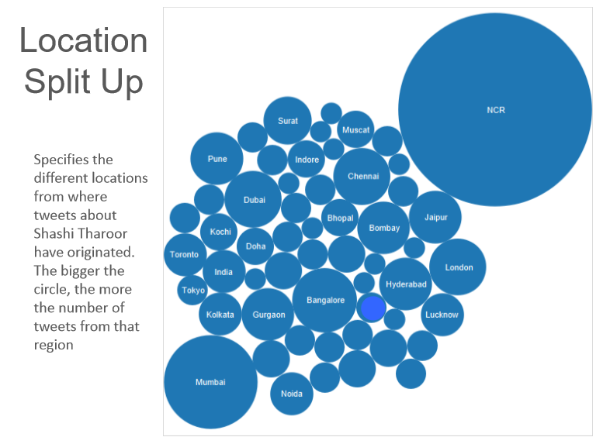
Visualization

Slide 16
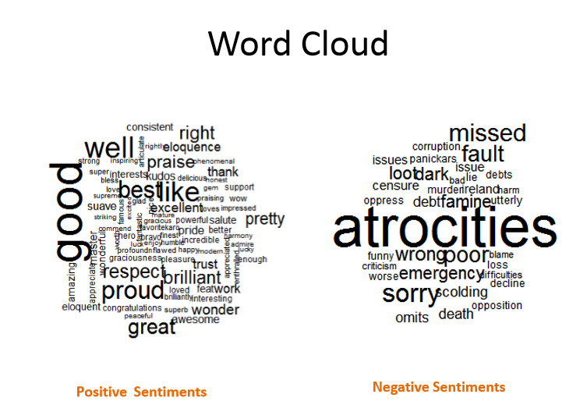
Visualization

Slide 17
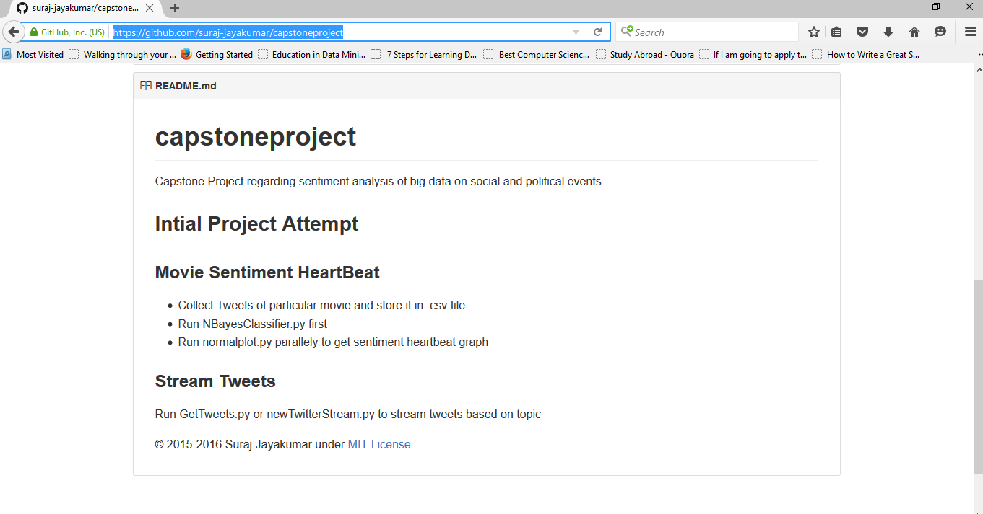
Open-Source

Slide 18
Feasibilty
Video of Existing work on Movie Review

Slide 19
Thank you

